Slide 1
CLASS 2 GLOBALIZATION

Slide 2

WHAT IS GLOBALIZATION?
Globalization refers to the widening relationships among people from different parts of the world, which happen to be divided into nations
The term can refer to elimination of barriers to international movement of goods, services, capital, technology, and people, influencing the integration of the world
By eliminating barriers, globalization is leading to increased global interactions and interdependencies

Slide 3

ERA OF GLOBALIZATION
Three eras of globalization (Thomas Friedman)
Why operate on a global scale?
The Phases of Globalization by Thomas Friedman (Video)

Slide 4
FORCES DRIVING GLOBALIZATION
Government policies
Expanded cross-national cooperation
Increase in and application of technology
Liberalization of cross-border trade and resource movements
Development of services that support international business
Growth of consumer pressures
Increased global competition
Changing political situations (but, are these favorable to globalization right now with Trump instead of Biden will be at the helm? Did increases in populism are good for freeing trade ?

Slide 5
BENEFITS OF GLOBALIZATION
Economic Growth
Increases in the diversity and choice of consumer goods and factors of production
Increases in cross border flows and production of knowledge (and thus innovation)
Decreases in costs of production for some products ( e.g., through economies of scale )
Enhancement of technological catch-up of emerging economies
Increasing financial resources available to emerging economies
Increases in competition and productivity
Others?

Slide 6
COSTS OF GLOBALIZATION
Threats to sovereignty (please provide examples)
  Countries may be forced to reduce local labour regulations to meet the pressures imposed by foreign competition and free trade
  Small economies (overdependent on larger ones) may adopt policies to those demanded by nations upon which they depend, and may be subjected to pressures from large corporations
  Threats to national security, technology leaks to rival countries
  Globalization may threaten social structures and even language, undermining cultural sovereignty
Environmental damage resulting from global economic growth
  What are the counterarguments to this?
Growing income inequalities between and within countries
  Why does income inequality between nations matter?
  Why does inequality within nations matter?

Slide 7
THE COSTS OF GLOBALIZATION CAN BECOME AN IMPORTANT POLITICAL ISSUE
Offshoring, a type of outsourcing, involves the transferring of production abroad
  it can be beneficial because it reduces costs
  but, it also means that jobs move abroad
  This can become a hot political issue that mobilizes forces opposing to globalization
  Yet, offshoring may also create new, better jobs at home. (More on the political economy of globalization in a future class)

Slide 8
INTERDEPENDENCE AMONG NATIONS
Why is interdependence increasing in response to globalization?
What are the problems that it creates, and what is needed to ensure quick and effective resolution of problems that arise?
Would increasing national barriers solve these problems?
What is the cost of increased national barriers?

Slide 9
HOW DO PROBLEMS OF NATIONAL INTERDEPENDENCE GET SOLVED?
Government coordination along national borders usually are resolved by unilateral action or through negotiation between neighbors (but sometimes end up in war).
Some cross-border inefficiencies cannot be solved alone or by coordination with immediate neighbours (e.g., trains between Sweden and Italy must change locomotives to accommodate different rail systems).These require negotiation of regional treaties.
There are many situations where policies of one government can affect those of others – e.g., changing interest rates in one country can attract funds very quickly from other countries, changing their domestic investment. Policy coordination is required. To coordinate economic policy e.g., large countries meet regularly to share information, pool ideas and reach agreements about coordination principles(e.g., G7 and G20 summits)
Decision about protection and regulation of areas outside national territories (oceans, space, etc.) require international treaties of potential stakeholders.
Development of Multilateral agreements and institutions is needed to govern critical areas such as trade (WTO) or health(WHO)----Problems of enforcement and difficulty to reaching agreements (e.g., Climate Change) result in weak governance.

Slide 10
The Scope and Scale of Globalization-Realities and perceptions
While the scope of globalization includes many dimensions we shall focus on in the following presentation on trade, Investment and financial flows
In this class we will mainly address developments in the 2-3 decades before 2008.
Notes:
Why?

Slide 11
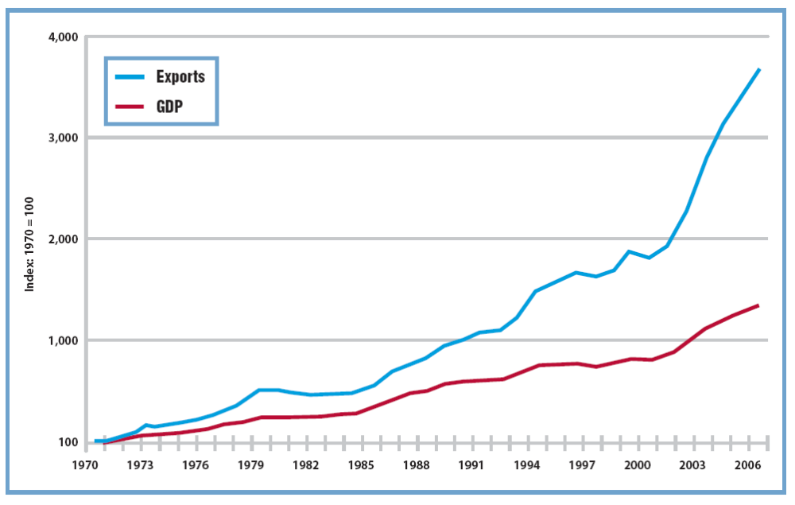
COMPARING THE GROWTH RATES OF WORLD GDP AND WORLD EXPORTS (CAVUSGIL ET AL.):THE PERIOD OF RAPID GLOBALIZATION (BEFORE 2008)

Slide 12
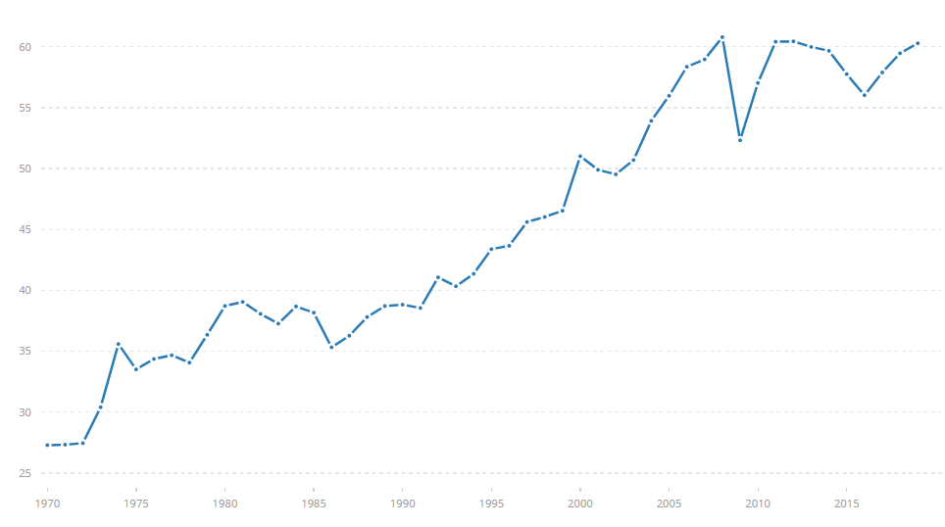
INTERNATIONAL TRADE (% OF GDP, 1970-2019)
World Bank national accounts data, and OECD National Accounts data files
Notes:
Trade is the sum of exports and imports of goods and services measured as a share of gross domestic product.
https://data.worldbank.org/indicator/NE.TRD.GNFS.ZS?end=2019&start=1970&view=chart

Slide 13
MARKET INTEGRATION
By 2008 about 25% of world products sold outside of country of origin compared to only 7% in 1950s
Export/Import GDP cyclical behavior: When GDP grows exports grow faster, when GDP declines exports decline faster

Slide 14
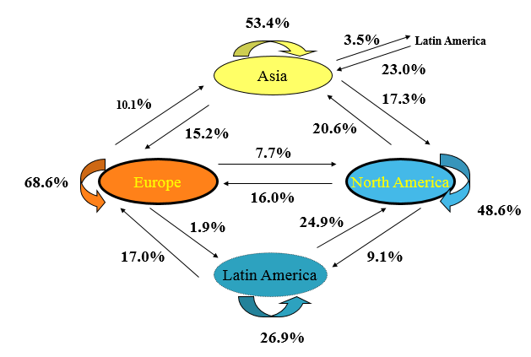
INTERNATIONAL EXPORT FLOWS (2012) - TRADE IS REGIONAL
Source: WTO International Trade Statistics 2013

Slide 15
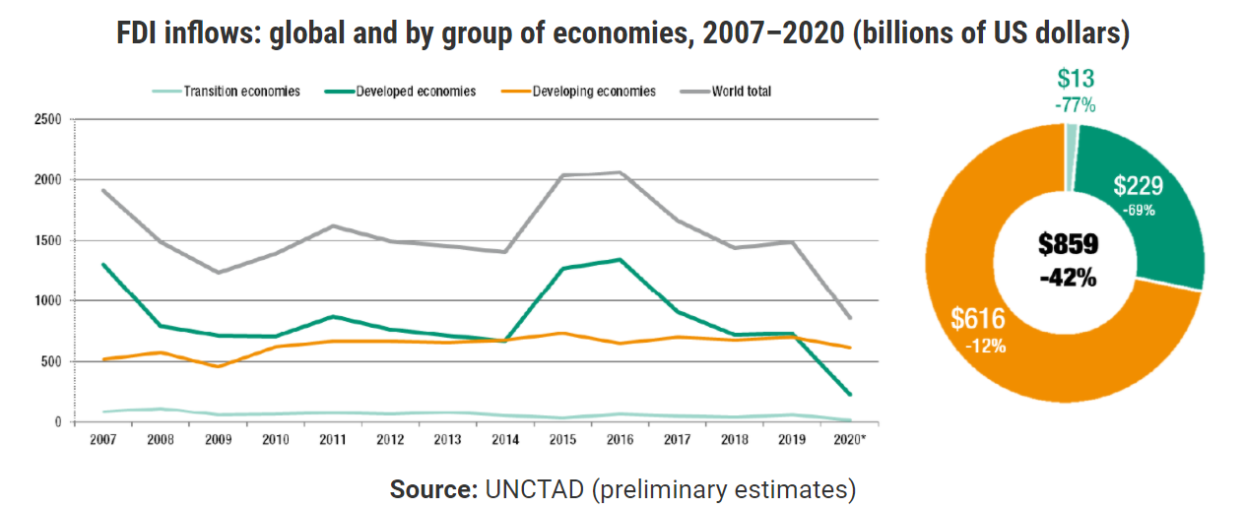
FOREIGN DIRECT INVESTMENT
Notes:
Global foreign direct investment fell by 42% in 2020, outlook remains weak
https://unctad.org/news/global-foreign-direct-investment-fell-42-2020-outlook-remains-weak

Slide 16
FINANCIAL GLOBALIZATION
Financial globalization was pushed by the expansion in trade and the desire of governments to promote efficiency and innovation in domestic financial markets which led to deregulation.
Growing trade required the development of a financial infrastructure to support global supply chains.
Large trade flows make it easier for firms to evade capital controls by over or under invoicing.
The agreement concerning financial services under GATS promoted openness to foreign financial institutions especially by new members such as China.
By 2011 around 1000 foreign banks had a presence in developing countries, accounting for about 40% of bank lending (up from 20% just over a decade earlier).

Slide 17

GLOBAL CROSS BORDER CAPITAL FLOWS
Cross border financial flows have grown in the decade leading to 2005 by 10.7% annually outpacing GDP growth (3.5%) and trade (5.8%) and growth of financial stock (8.7%).

Slide 18
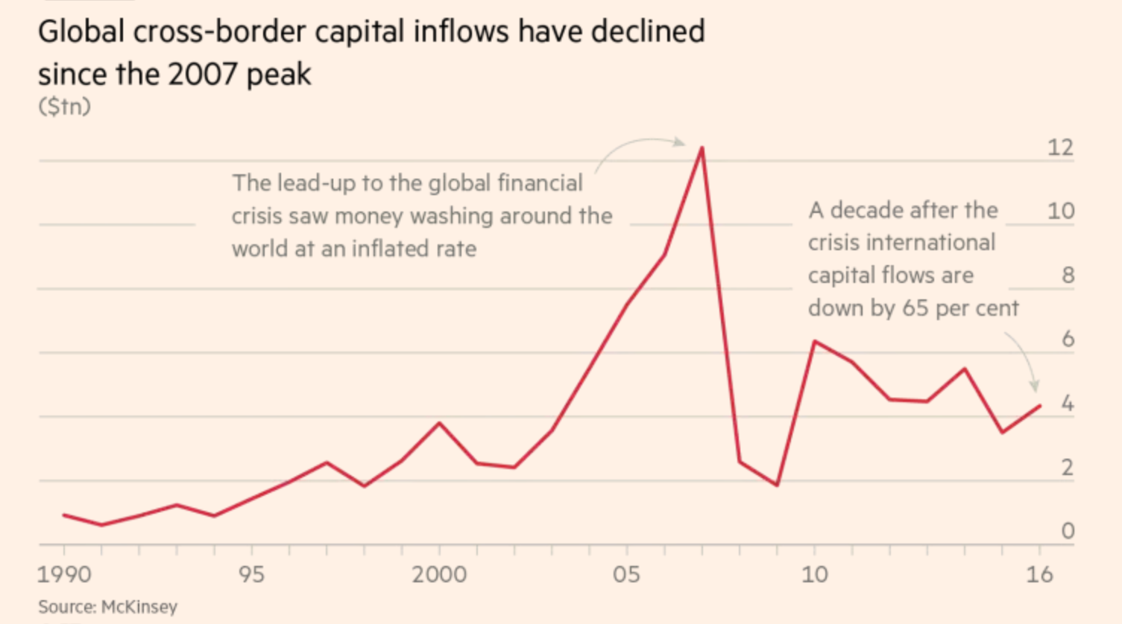
GLOBAL CROSS-BORDER CAPITAL INFLOWS ($ TRILLION)
Source: McKinsey 2017

Slide 19
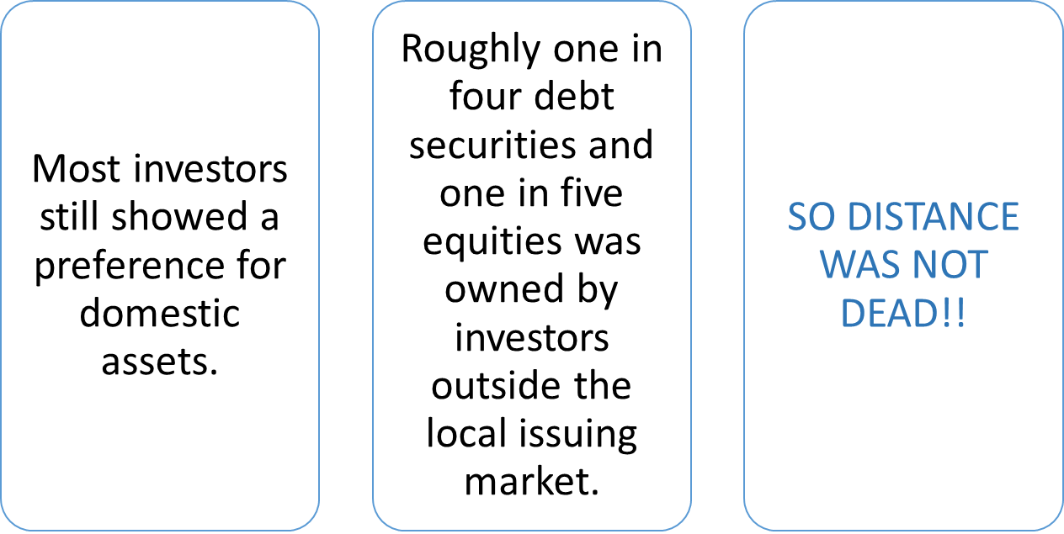
WAS DISTANCE DEAD IN FINANCIAL MARKETS ?

Slide 20
WHAT BUSINESS LEADERS BELIEVED ABOUT THE DEPTH OF GLOBALIZATION BEFORE 2008? GHEMAWAT HBR JULY-AUGUST 2017
As of 2008 business leaders believed that the world was becoming flat(indeed Freedman’s book was a best seller)and that MNEs were unconstrained by country borders.
Ghemawat’s surveys found that even experienced executives over- estimated the intensity of international business flows relative to domestic ones.
He has found also that those executives that have misperceived the depth of globalization were more likely to believe erroneous statements about international business strategy. For example, when people believe in deeper levels of globalization than the real ones they tend to underestimate the need to understand and respond to differences across countries when operating abroad.
People tend to overestimate the breadth of globalization(the degree that international activities are distributed globally rather than narrowly focused)
Interestingly in the public policy sphere, leaders tend to over estimate the costs of globalization and underestimate the benefits that accrue from globalization.
In contrast to evidence 62% of HBR surveyed in 2007 believed that geography ,distance even in the near future language, do not effect collaboration on research and work in real time.

Slide 21
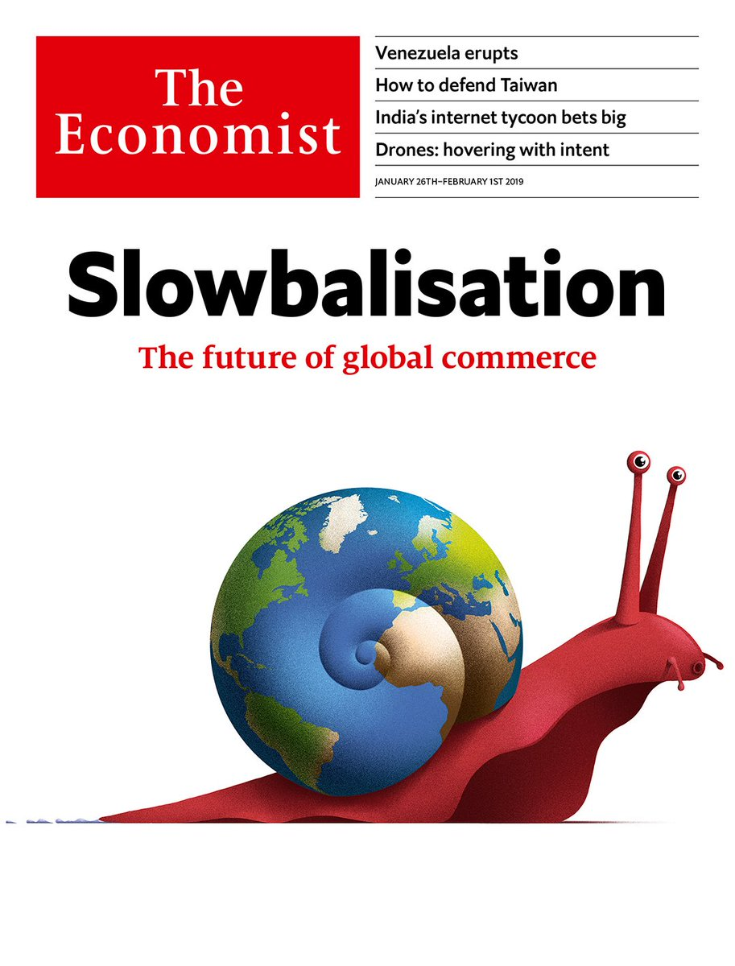
?
The future of Globalization

